Slide 1


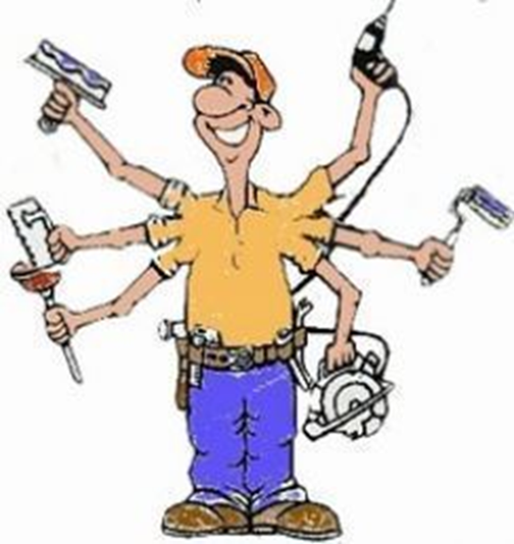
Kwa Thema Skills School
(School Of Specialization)
Maintenance Year 1 Learning Content

Slide 2
Maintenance Year 4
Learning Content
1. Safety Rules in Woodwork Maintenance
2. Basic Hand Tools and Their Purposes
3. Hand Tools Maintenance
4. Basic Power Tools and Their Purposes
5. Power Tools Maintenance
6. Different Types Of Sandpapers, Their Grits And Uses
7. Basic Hinges And Their Uses.
8. Basic Locks And Their Uses.
9. Manufacture A Jewelry Box.

Slide 3
Overview of Maintenance
- Maintenance management is vital in ensuring the long term success of your maintenance program by monitoring quality assurance, maintaining operational efficiency and keeping assets in optimum running order.
- Properly maintained assets and resources keep your production stable and greatly minimize the chances for unplanned downtime.
At the end of the term learners should be able to:
1. Apply safety rules in the workshop.
2. Name or identify marking and cutting hand tools.
3. To know the uses of making and cutting hand tools.
4. Maintain hand and power tools or machines.
5. To know different types and sizes of sandpapers.
6. To different types of hinges.
7.To know different types of locks.
8. To make a Jewelry Box.

